Slide 1
Access Control policies Who gets to do what to what….

Slide 2

Protecting what needs to be protected with the available technologies!
Access control is the of Information Security!

Slide 3
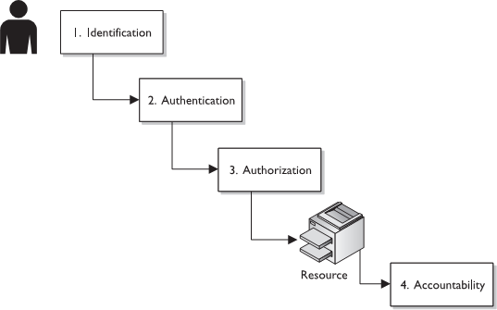
Access Control

Slide 4
Access Control
What is Access?
What is the Access Mechanism?
What is Access Control?
The right
Flow of information between subject and object
Mechanism to protect the assets!

Slide 5
Access Control
Frameworks that dictate how subjects access objects
Four Main Types
Discretionary Access Control (DAC)
Mandatory Access Control (MAC)
Role Based Access Control (RBAC)
Attribute-Based Access Control(ABAC)

Slide 6
Discretionary Access Control
Allows the owner of the resource to specify which subjects can access which resources
Access control is at the discretion of the owner
DAC defines access control policy
– That restricts access to files and other system resources based
on identity
DAC can be implemented through Access Control Lists (ACLs)

Slide 7
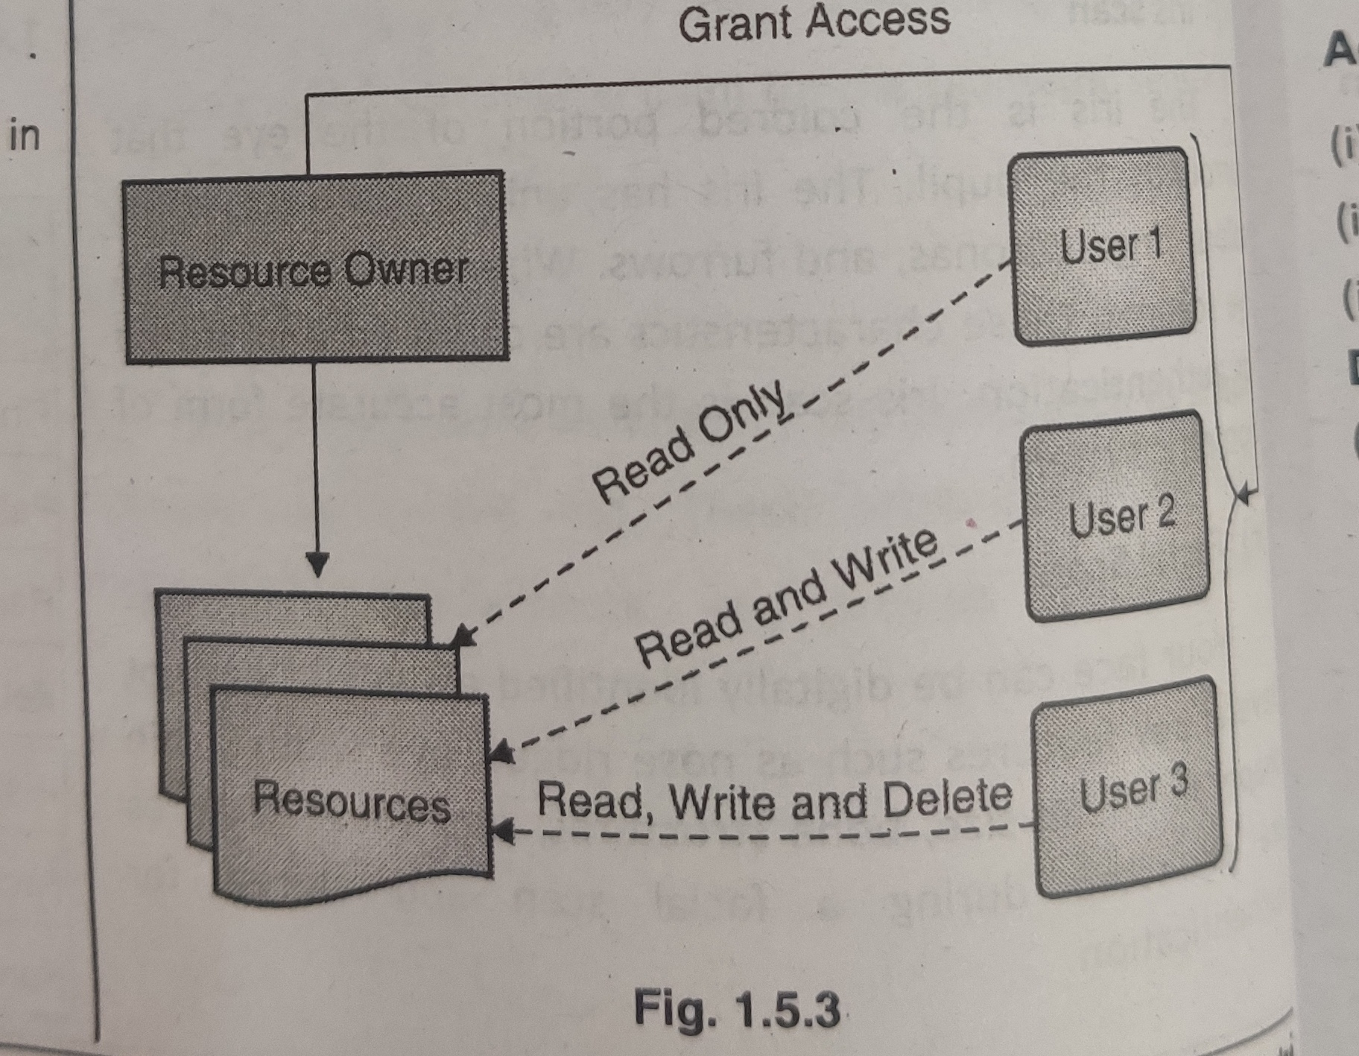
Discretionary Access Control

Slide 8
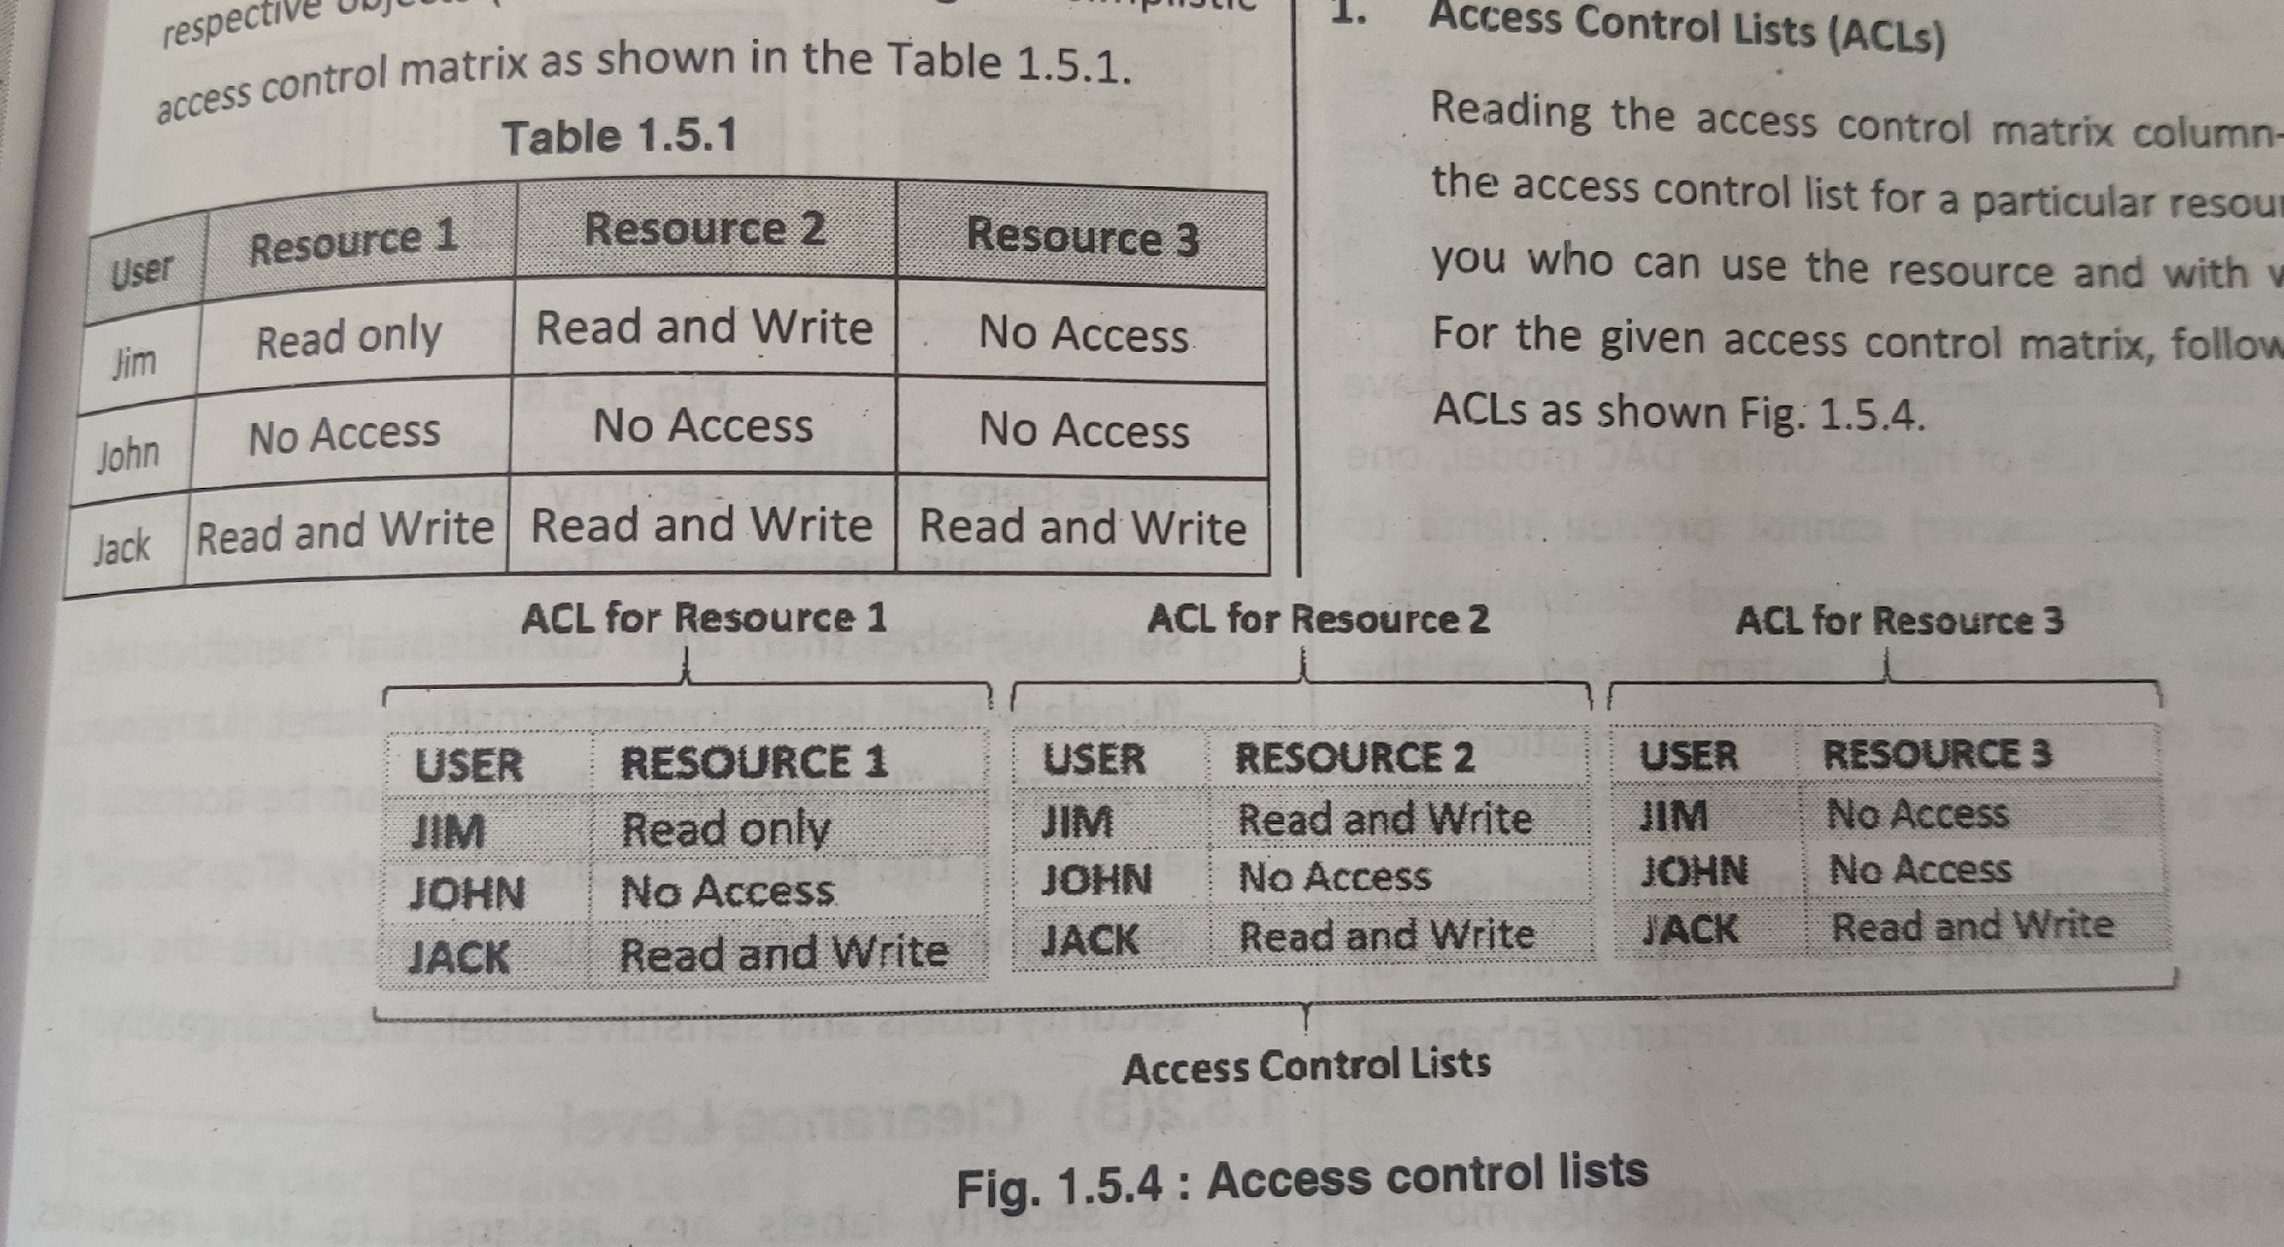
Discretionary Access Control

Slide 9
Adv./Disadv. Of Discretionary Access Control
Advantages
Easy to understand
Easy to implement
Flexibility to assign/ revoke rights on the individual basis.
Disadvantages
Careful evaluation and administration of each resource, user and her rights periodically
Once permission given, the user will have an unrestricted access
If a user mistakenly installs a malware program, the malware will inherit all the DAC permissions that were assigned to the user.
As the no. of users increase, it will become difficult to manage them and provide individual access right to each one of them.

Slide 10
Mandatory Access Control
MAC is considered a policy based control
This restricts access to system resources based on their sensitivity and the authorization level of the entity trying to access the resources
Used where confidentiality is of utmost importance
Every object and subject is given a sensitivity label
Classification level
Secret, Top secret, Confidential, sensitive, unclassified etc
Category
Information warfare, Treasury, UN, etc

Slide 11
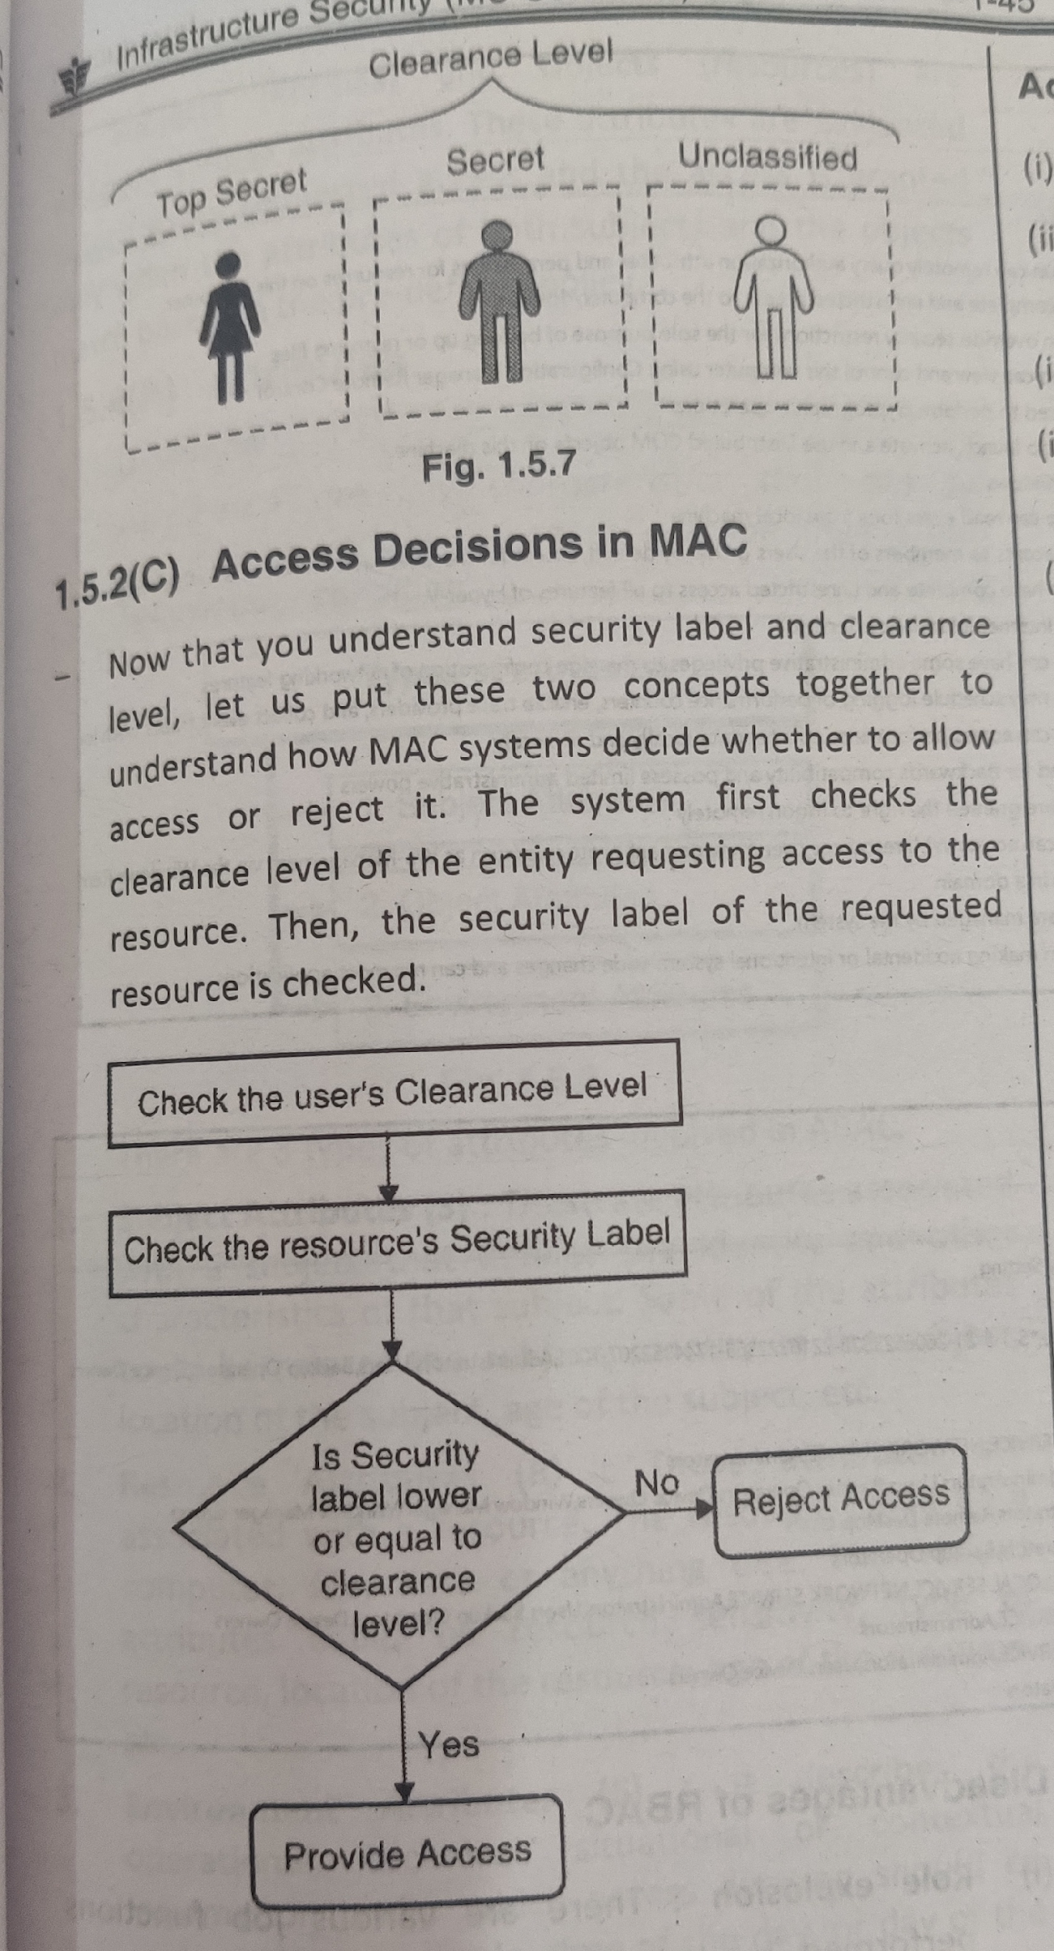
Mandatory Access Control

Slide 12
Mandatory Access Control
If the security label of the requested resource is lower or equal to the clearance level of the requesting entity then the access is provided.
If the security label of the requested resource is higher than the clearance level of the requesting entity then the access is rejected.
As a rule, an entity (person/ device) is allowed to access resources that are marked with a security label lower or equal to its own clearance level.

Slide 13
Adv/Disadv. Of Mandatory Access Control
Advantages
All resources on the system are adequately labelled
Access decisions are automatic based on the clearance level
System-wide enforcement
It is scalable model, individual users are not required to provide access rights.
Disadvantages
Inflexible to provide any specialized access
Difficult o understand as compared to DAC

Slide 14
Role-Based Access Control
RBAC is an access control model for controlling access to resources where permitted actions on resources are identified with roles rather than with individual subject identities.
On a windows platform users can be defined with their roles by the administrator
And the roles can be hierarchical. Admin level people vs. guest level
A user may also be assigned more than one role on a system

Slide 15
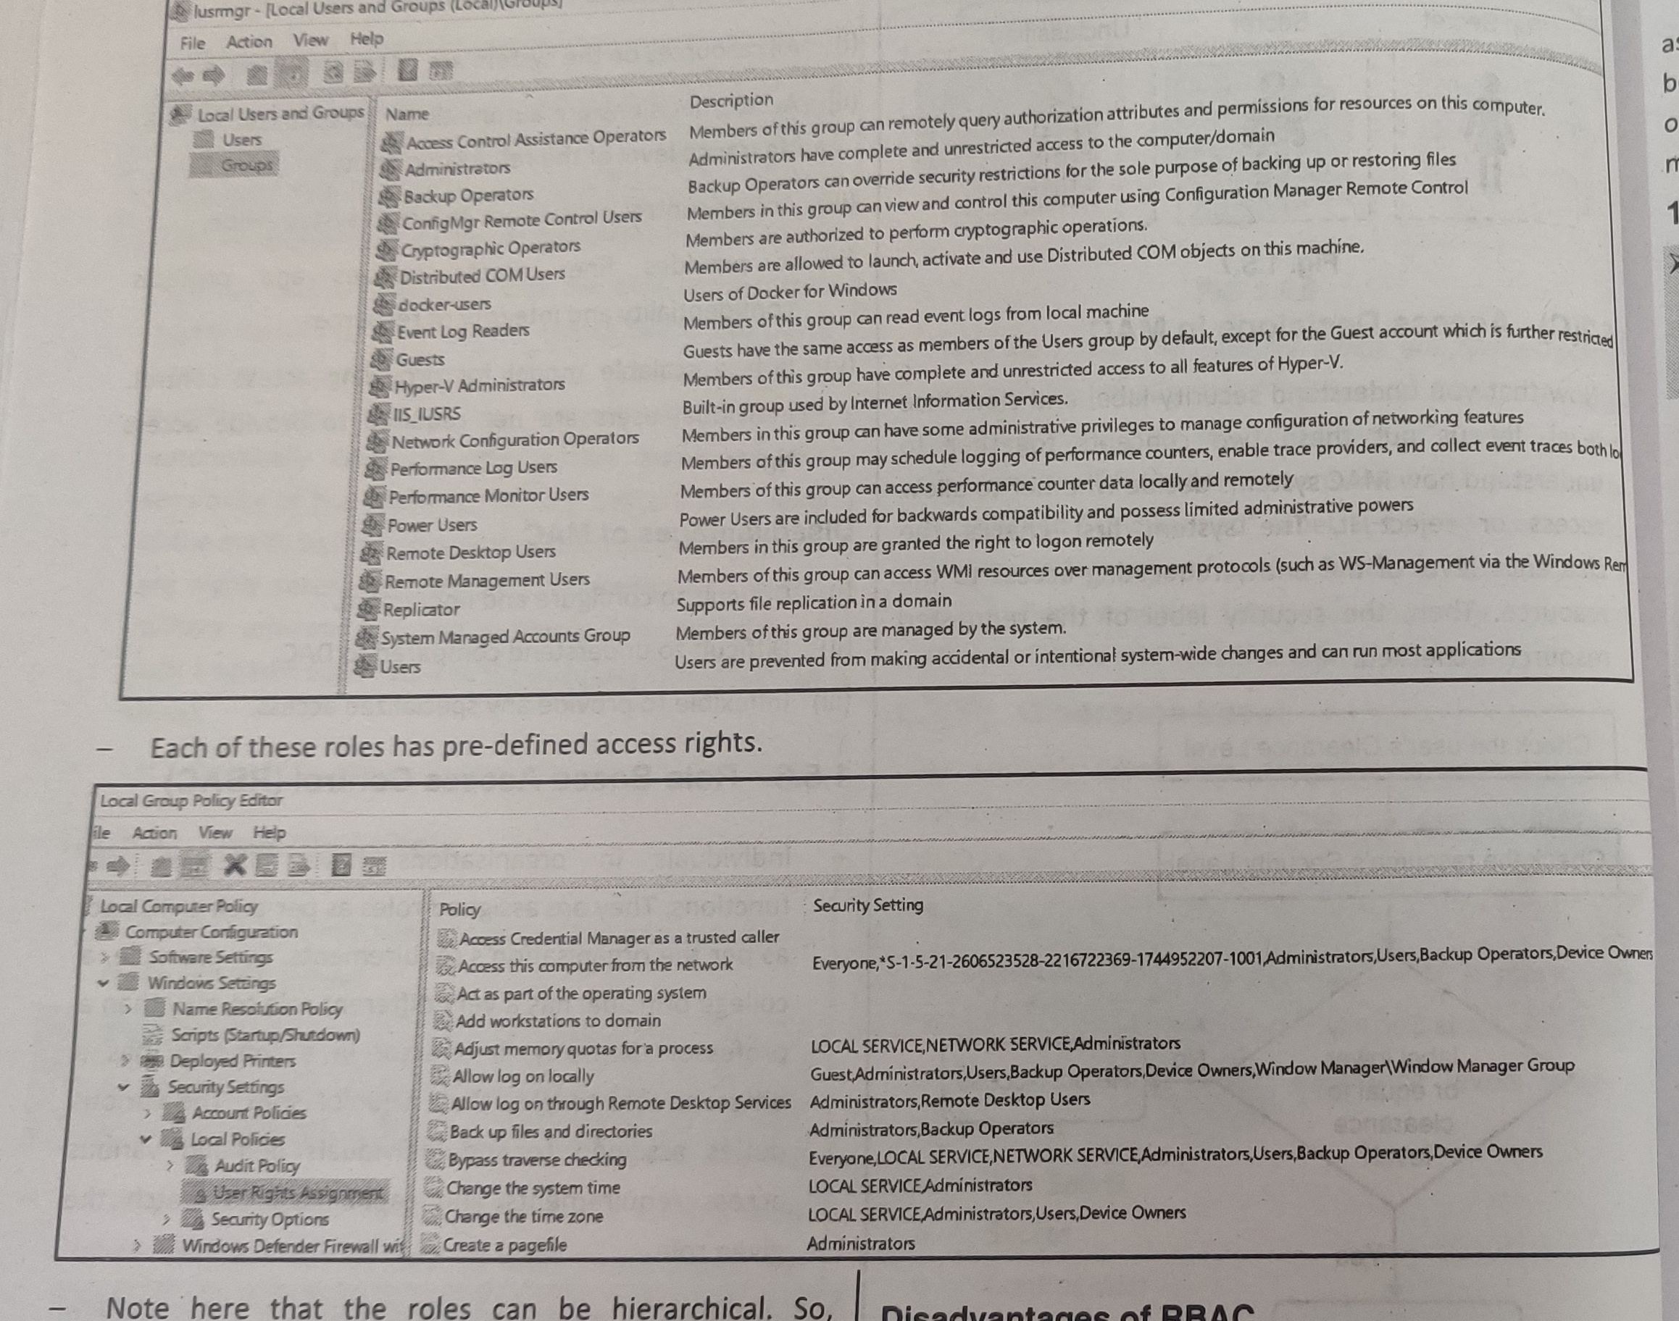
Role-Based Access Control

Slide 16
Adv/Disadv. Of Role–Based Access Control
Advantages
Roles fit more naturally to the job function rather than the individual (bank/hospital/insurance)
Easy administration- employees can leave and go without needing to change the defined rights for a given role
Disadvantages
Not all systems support fully functional RBAC capability
There are various job functions performed by individuals in an organization. It is complex to define precise role requirement for each task and manage them

Slide 17
Attribute-Based Access Control(ABAC)
In ABAC access is decided by the policy enforced on subject and object attributes.
Types of attributes
Subject Attributes
Object Attributes
Environment Attributes

Slide 18
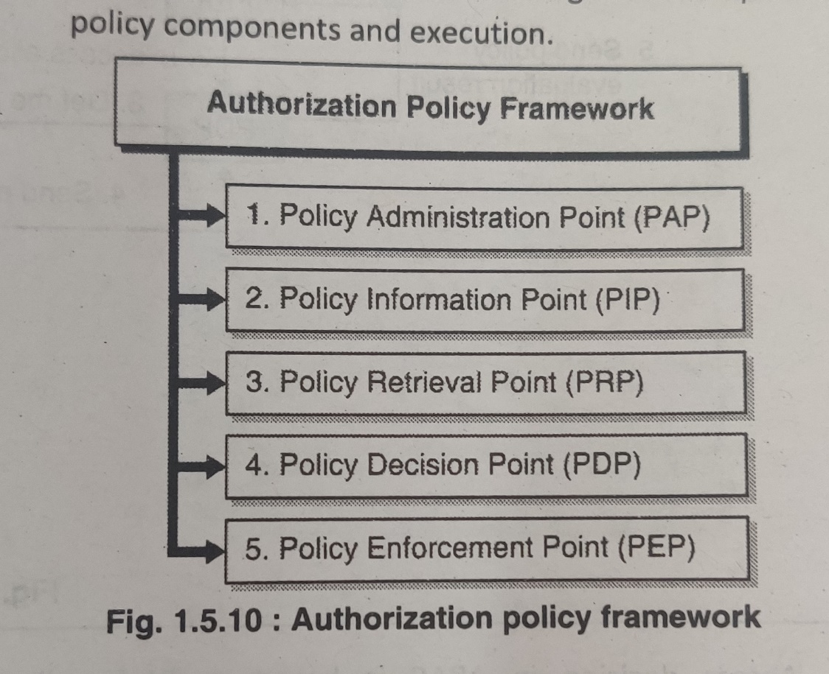
Attribute-Based Access Control(ABAC)
PAP : general administration like defining new policies, editing, deleting
PIP : provides attribute values for subjects, resources and environment
PRP: a database where policies are stored
PDP : if then else rules
PEP : receive all access requests for accessing resources

Slide 19
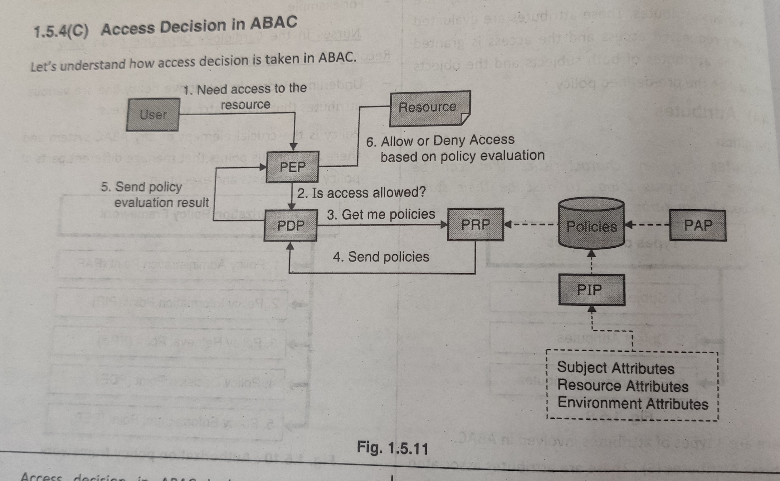
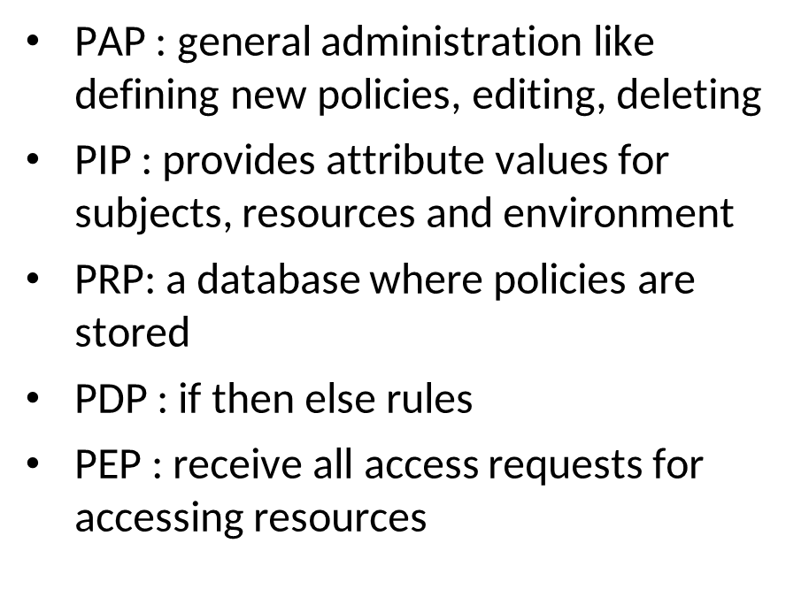
Attribute-Based Access Control(ABAC)

Slide 20
Adv/Disadv. Of Attribute–Based Access Control
Advantages
Flexible to give permissions at the granular level conditions
Scalable
permissions can be granted in dynamic way, and also can be extended to external users
Disadvantages
Requires investment in infrastructure
Need to manage policies separately and periodically update

Slide 21
Security Models
Designing a secure system is a complex task
State Machine model (state transition model to ensure that the system is secure at all time/in all states)
Bell-LaPadula Model
Biba Model

Slide 22
Bell-LaPadula Model
This Model was invented by Scientists David Elliot Bell and Leonard .J. LaPadula.Thus this model is called the Bell-LaPadula Model.
This is used to maintain the Confidentiality of Security.
Is a state machine model which ensures confidentiality aspect of access control and was developed in 1970’s
For the US military to avoid disclosure of sensitive information.
Has four components
Subjects
Objects
Actions (r,w)
Security levels (top secret, secret, confidential, sensitive and unclassified)

Slide 23
Bell-LaPadula Model
Bell-LaPadula Model Rules
Simple Security Rule
Star Property Rule
Strong Star Property Rule
Discretionary Security Property

Slide 24
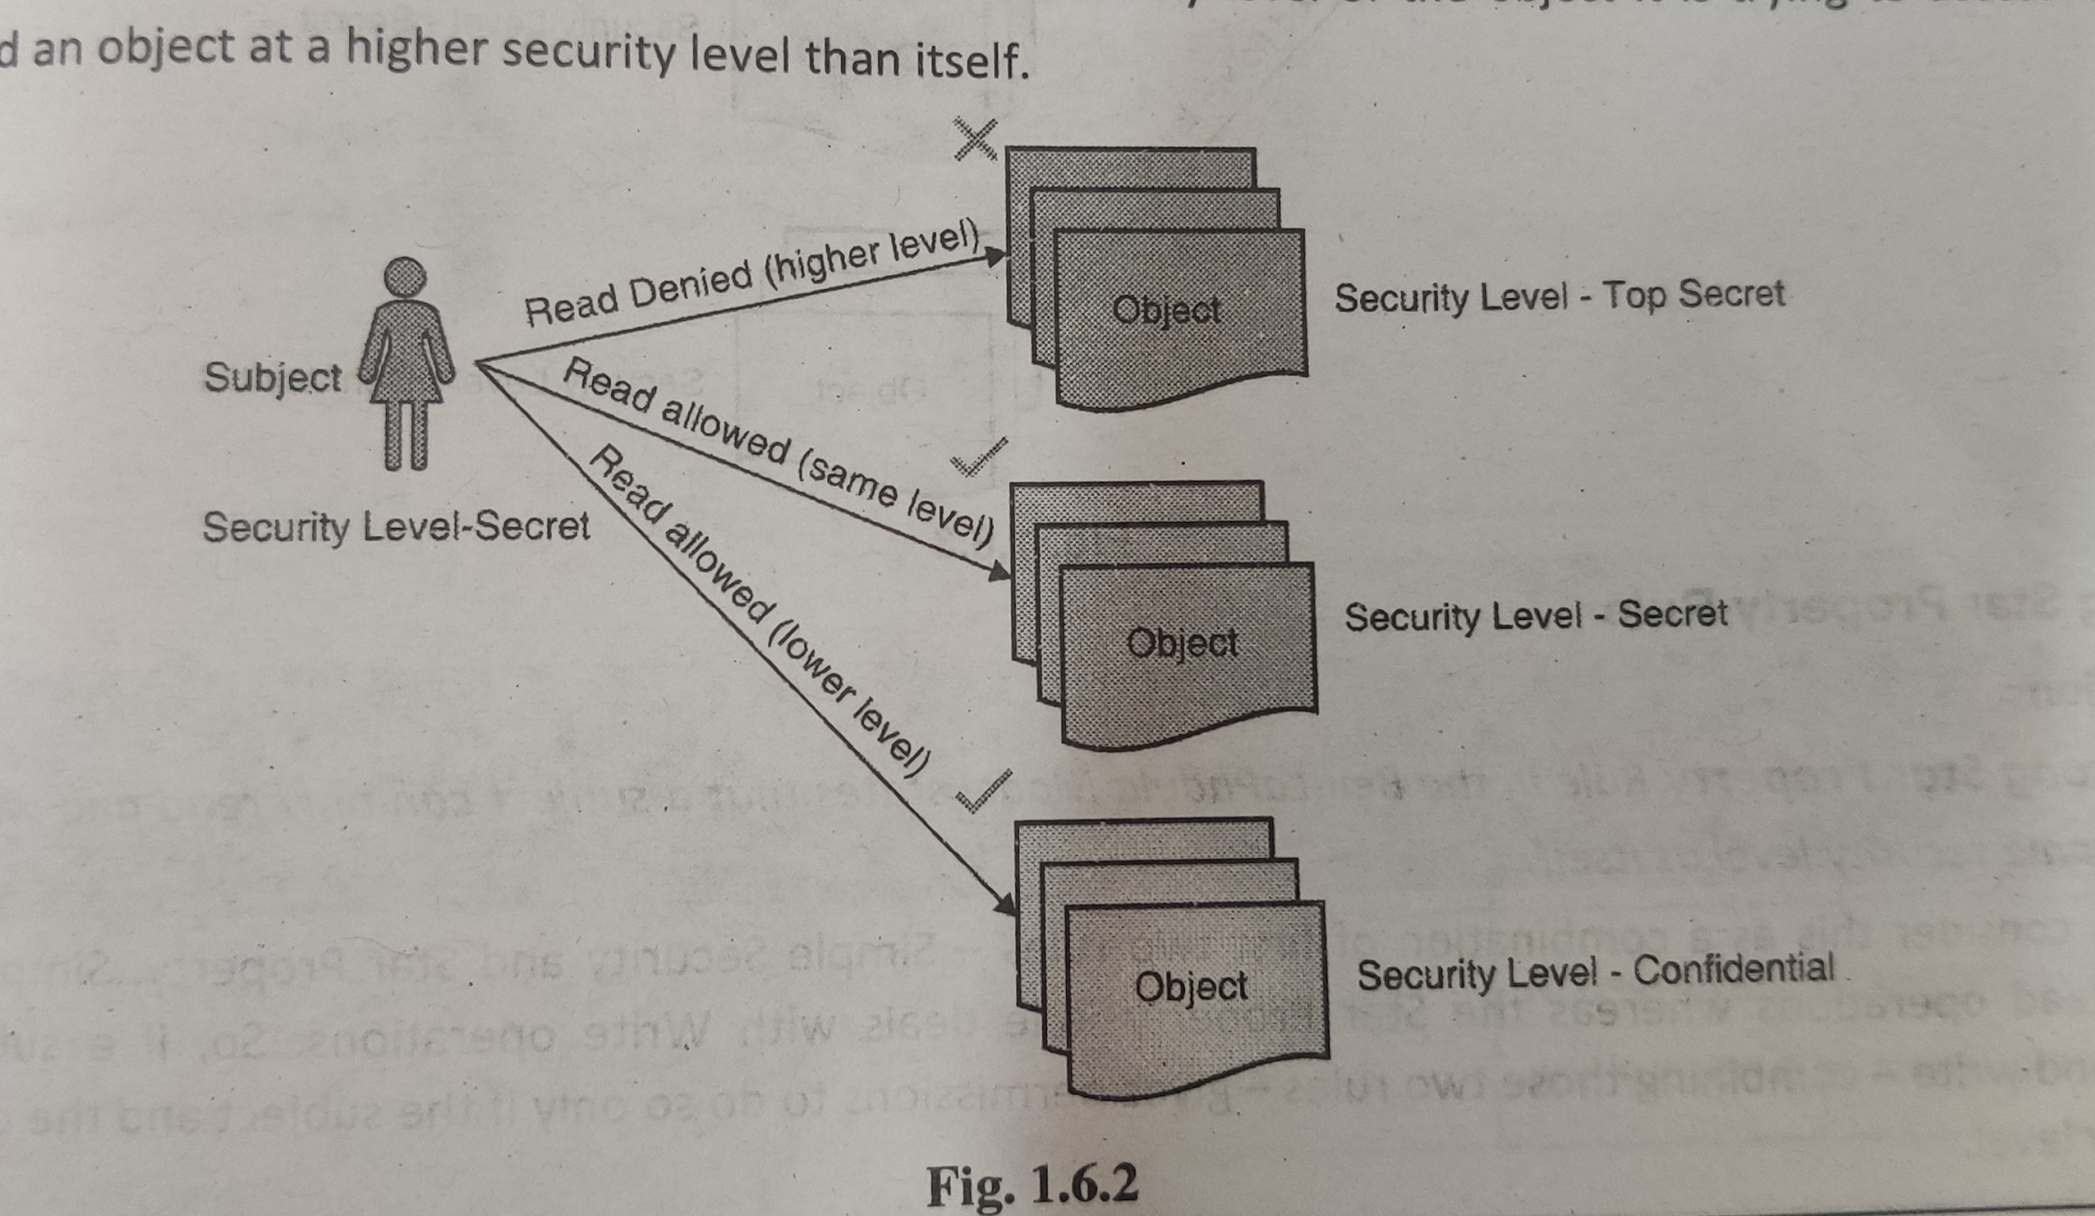
Bell-LaPadula Model
Simple Security Rule
A subject cannot read an object at a higher security level than itself

Slide 25
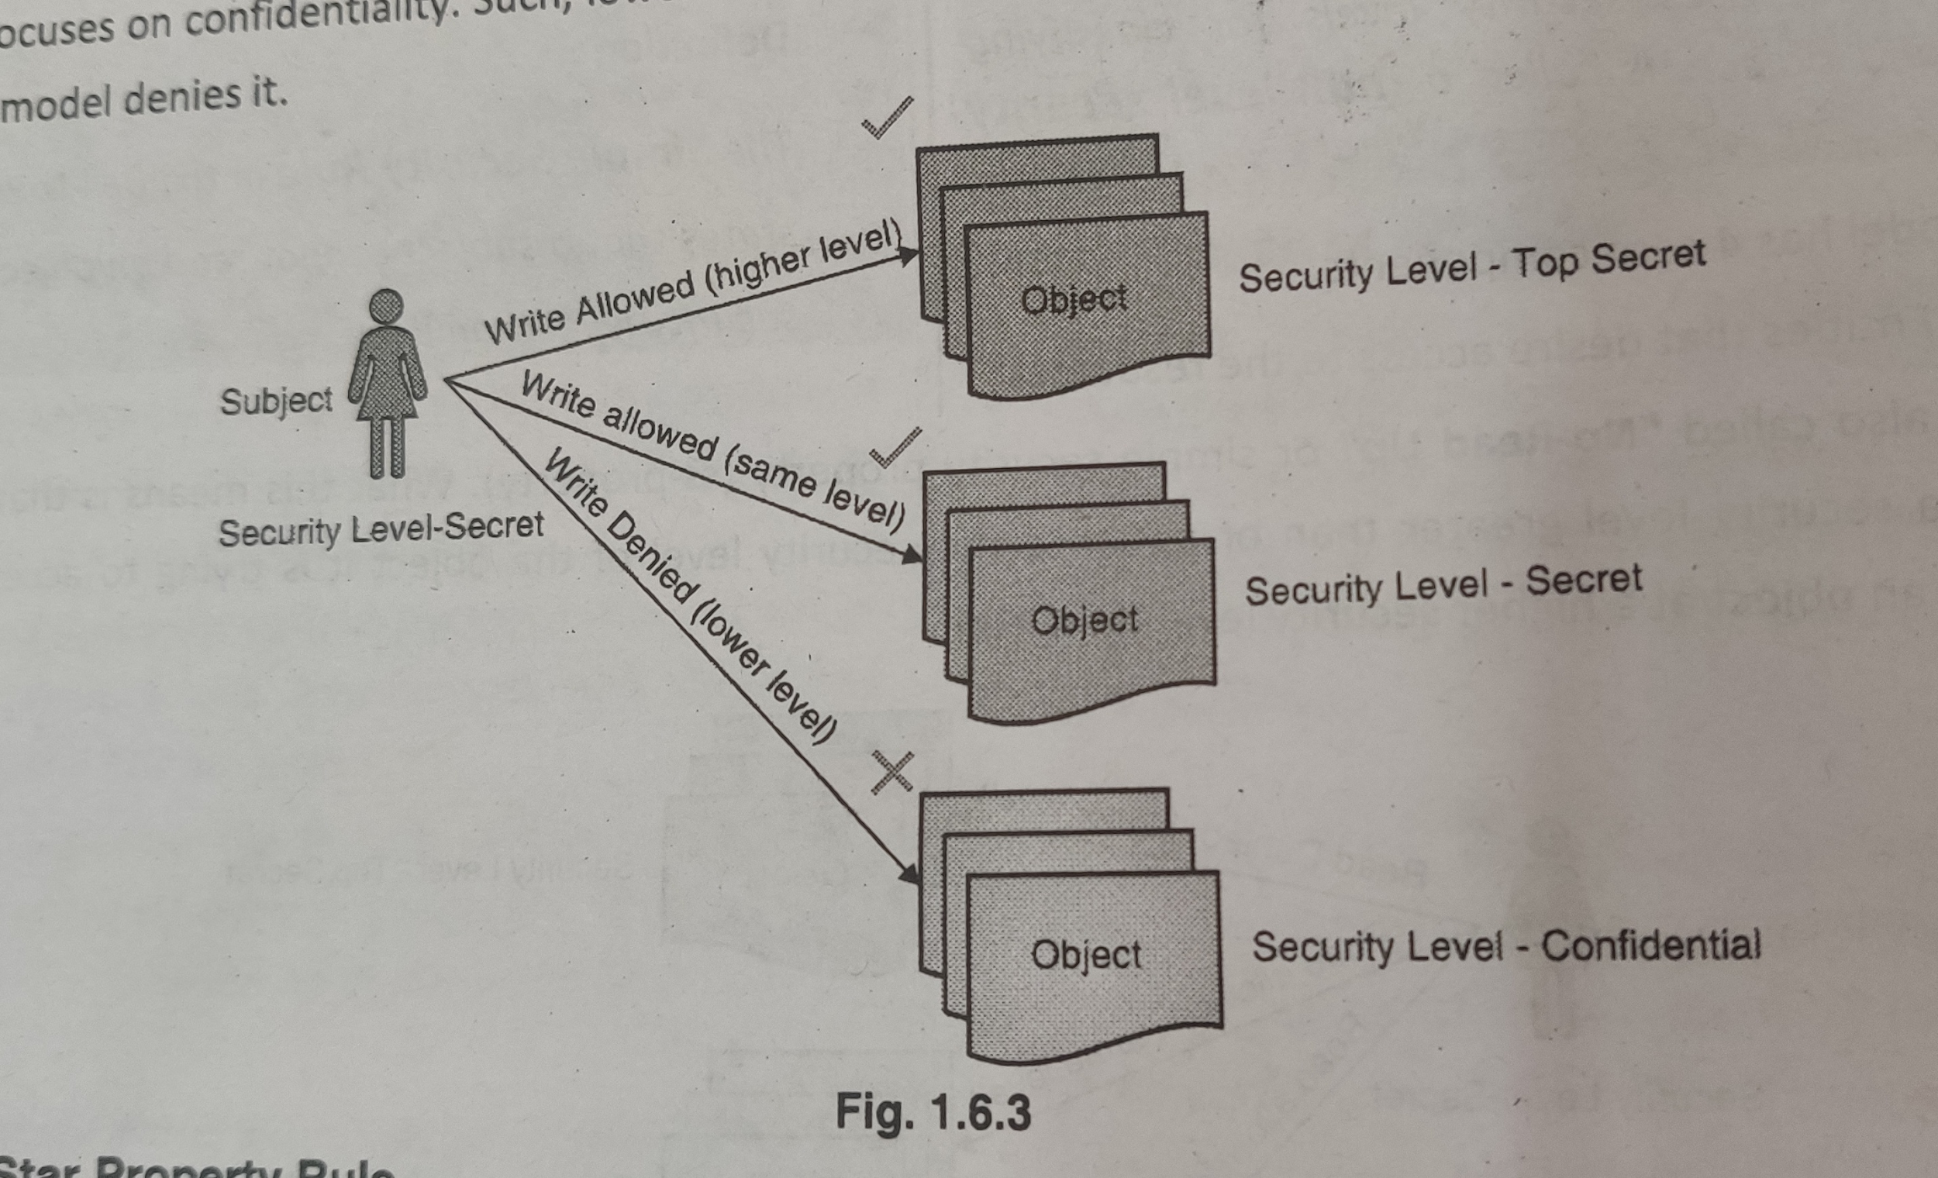
Bell-LaPadula Model
Star Property Rule
A subject cannot write to an object at a lower security level than itself

Slide 26
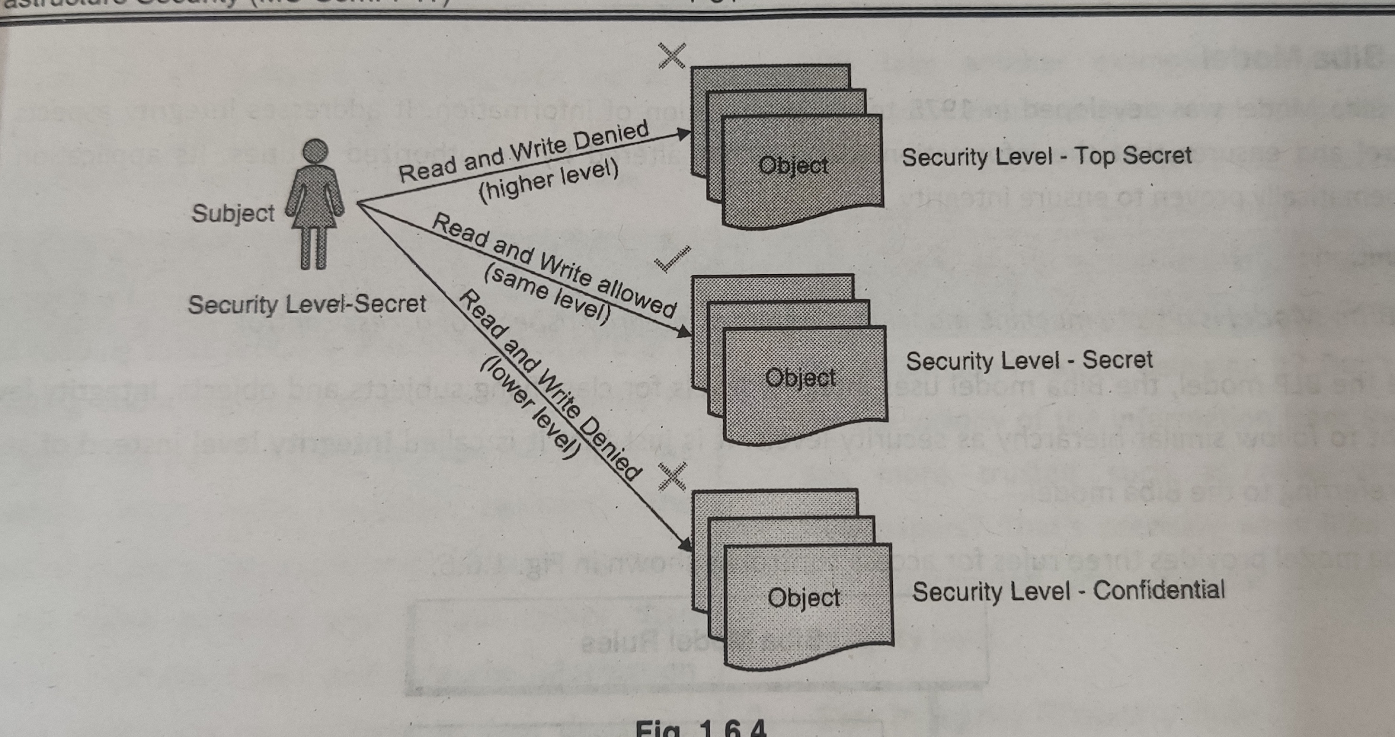
Bell-LaPadula Model
Strong Star Property Rule
A subject can only read and write to an object at a the same security level as itself.

Slide 27
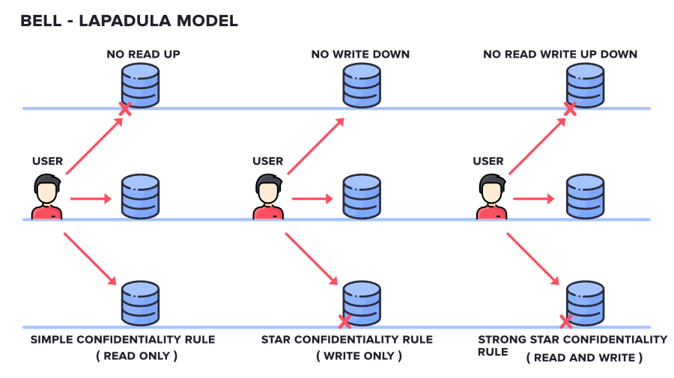
Bell-LaPadula Model

Slide 28
An example of Bell-LaPadula Model
TOP SECRET (TS): Lucy, Doc 1
SECRET (S): John, Doc 2
Lucy can read Doc 1 and Doc 2; Lucy can write Doc 1;
Lucy cannot write Doc 2
If Lucy can write Doc 2, she can copy the Doc 1 information into Doc 2, then John can read the unauthorised information
John can write Doc 1 and Doc 2; John can read Doc 2
John cannot read Doc 1

Slide 29
The Bell-LaPadula Model: Confidentiality Policy
Essentials
Term “classification”: A subject has a security clearance; An object has a security classification.
The higher the “level” of security clearance, the more sensitive the information
Policies
Simple Security Condition (No Reads Up)
Subject can read object when (&):
Subject’s Level >= Object’s Level
Subject has discretionary read access to Object
Property (Star Property) (No Writes Down)
Subject can write object when (&):
Subject’s Level <= Object’s Level
Subjects has discretionary write access to Object

Slide 30
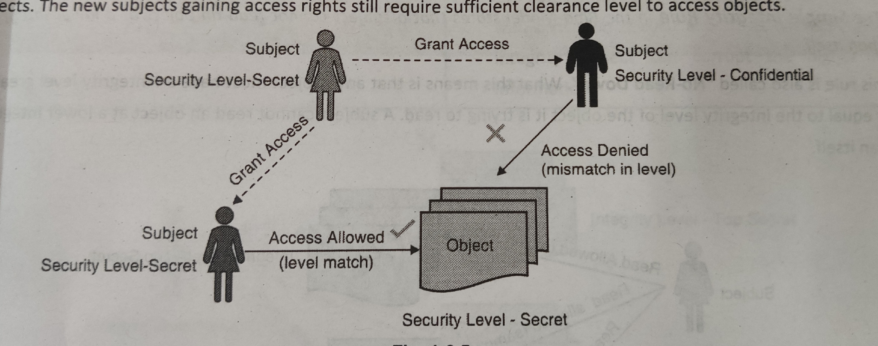
Bell-LaPadula Model
Discretionary Security Property
A subject can provide access to other subjects based on its own judgment.
The access for those subjects would still follow the security level-based rules of the model.

Slide 31
The simple way to remember the Bell-LaPadula model is: No read up, no write down.
Let's create four people Alice, Bob, Charlie, Diana, and Eve. Now let's give each one a label:
Alice is Confidential, Bob is Restricted, Charlie is Confidential, Diana is Secret, Eve is Top Secret. Each person creates a document, and when they create a document the document gets the same label as the person who created it. Alice creates Document A, Bob creates Document B, Charlie creates Document C, Diana creates Document D, and Eve creates Document E.
Create a simple table showing what happens when someone tries to read a document.

Slide 32
For Reading :
 | DOC A | DOC B | DOC C | DOC D | DOC E
Alice | allow | deny | deny | deny | deny
BOB | allow | allow | deny | deny | deny
Charlie | allow | allow | allow | deny | deny
Diana | allow | allow | allow | allow
EVE | allow | allow | allow | allow | allow
For writing??

Slide 33
Biba Model
This Model was invented by Scientist Kenneth .J. Biba. Thus this model is called Biba Model. This is used to maintain the Integrity of Security.
Unlike the BLP model, this uses integrity levels for classifying subjects and objects.
Three rules for access control
Simple Integrity rule
Star Integrity property rule
Invocation Property Rule

Slide 34
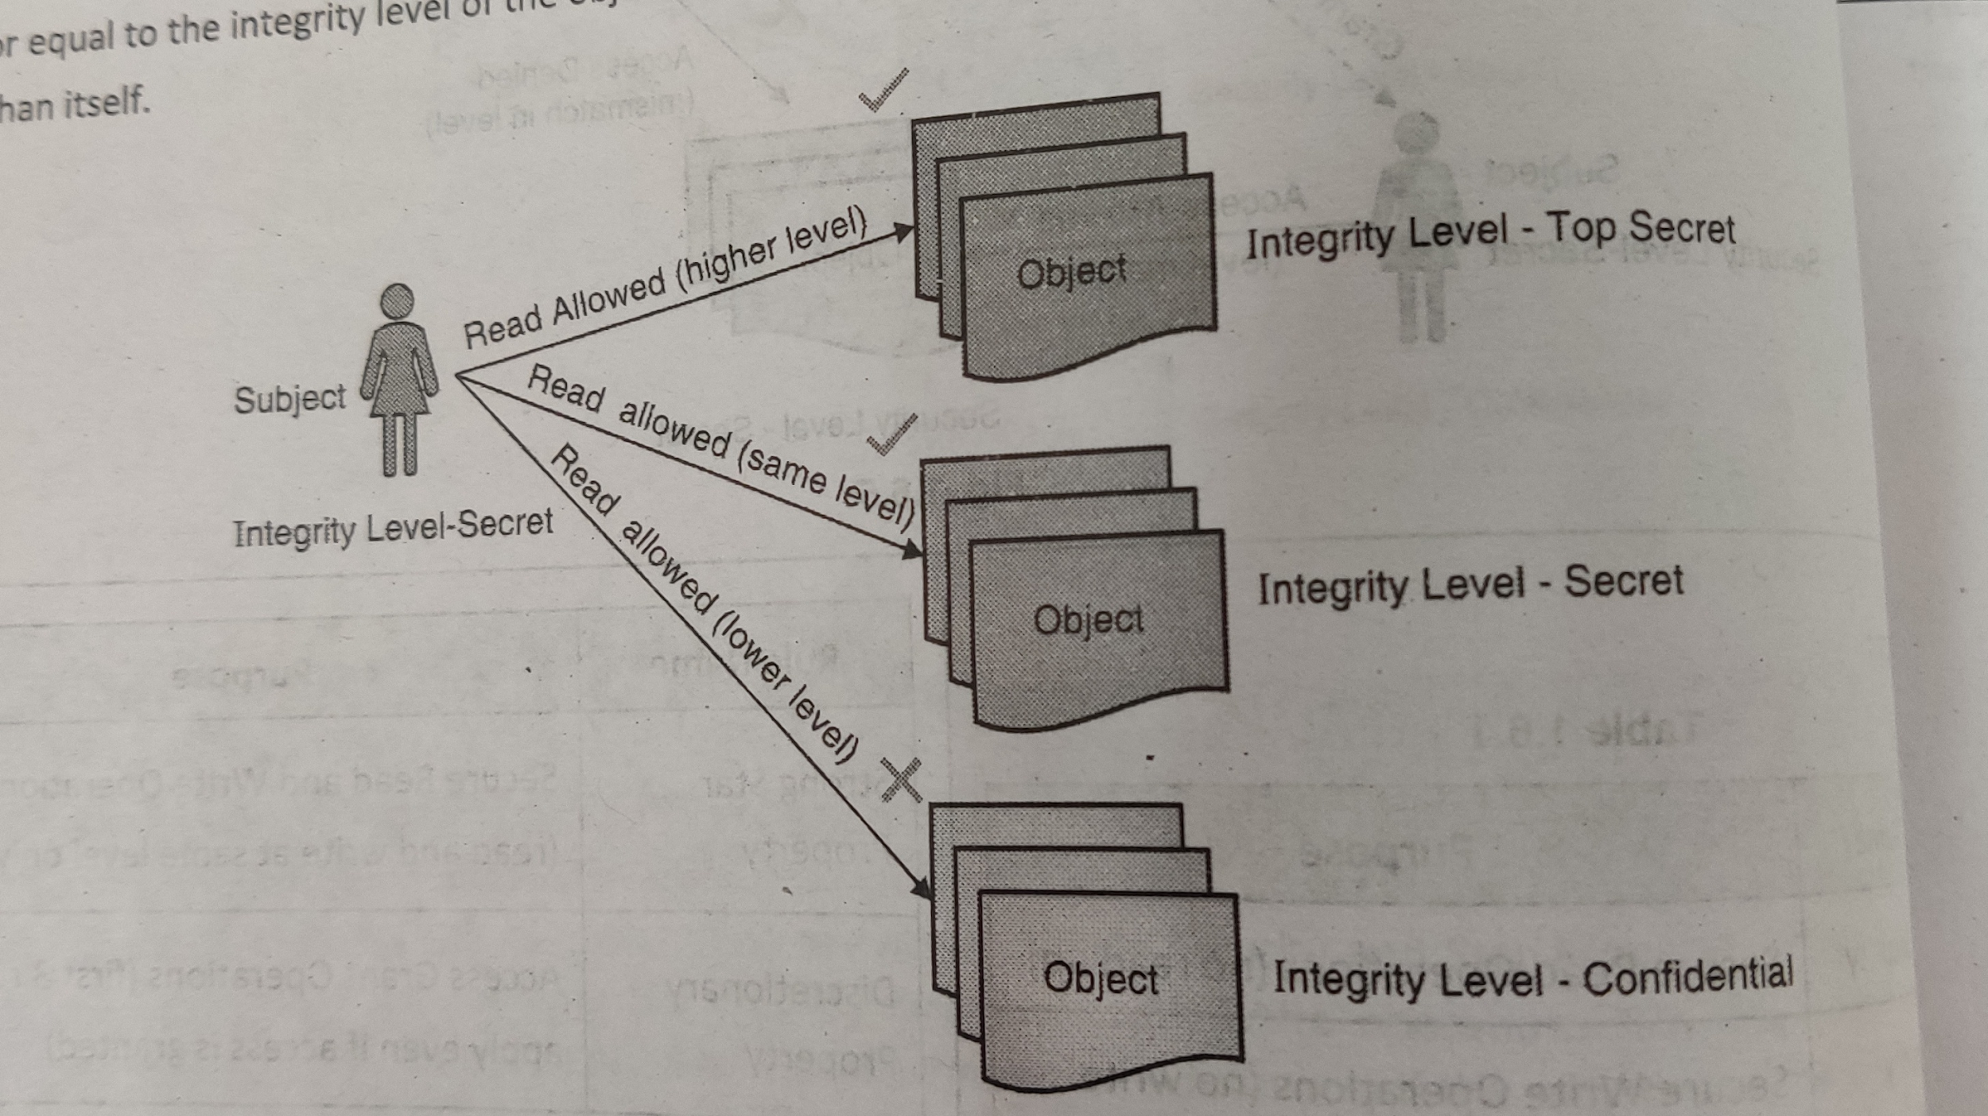
Biba Model
Simple Integrity rule
A subject cannot read an object at a lower integrity level than itself. (NO-Read Down)

Slide 35
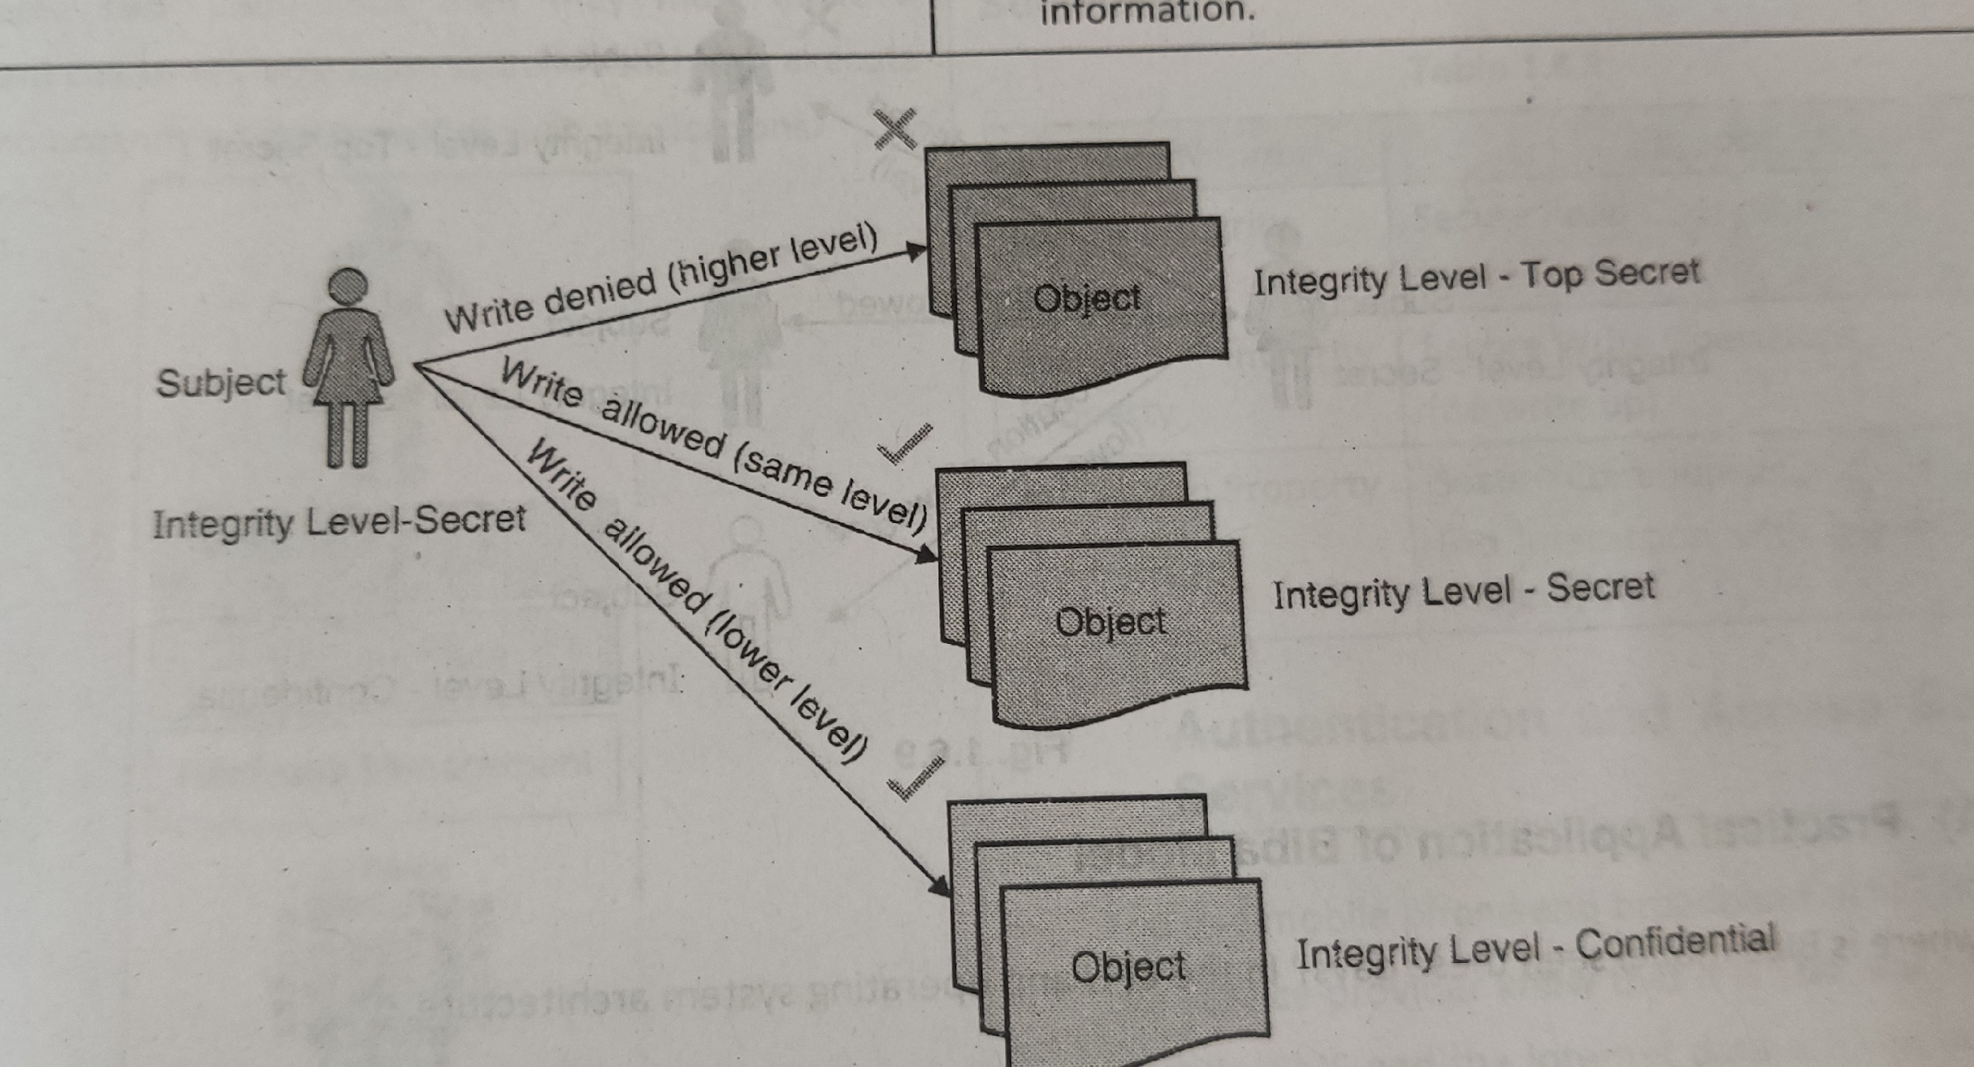
Biba Model
Star Integrity Property Rule
A subject cannot write to an object at a higher integrity level than itself. (NO-Write UP)

Slide 36
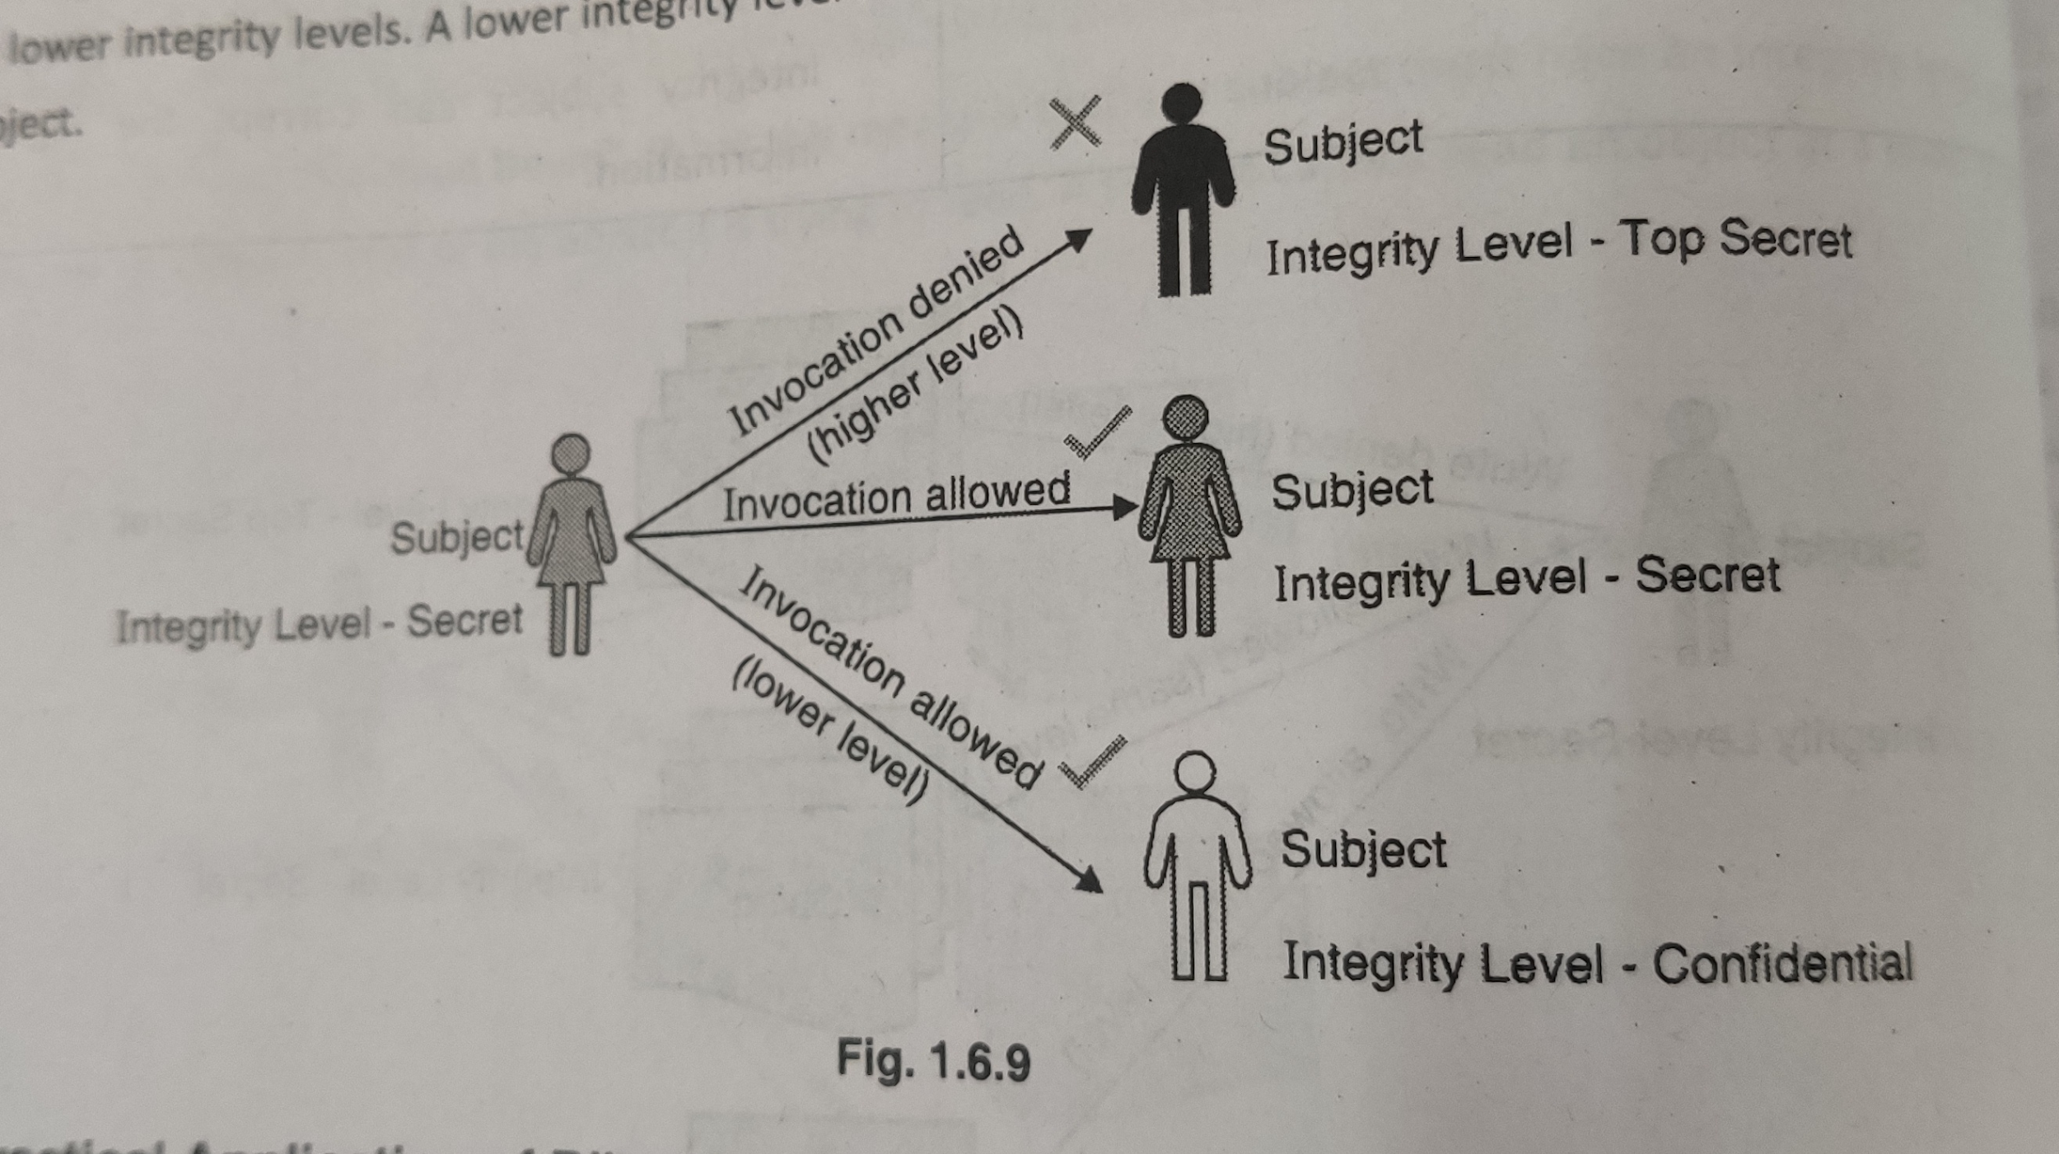
Biba Model
Invocation Property Rule
A subject cannot communicate with another subject at a higher integrity level than itself.

Slide 37
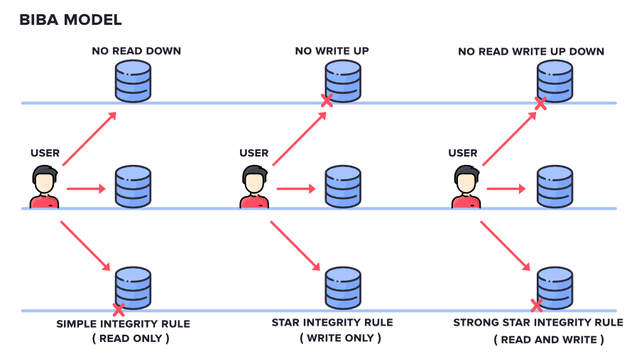
Biba Model

Slide 38
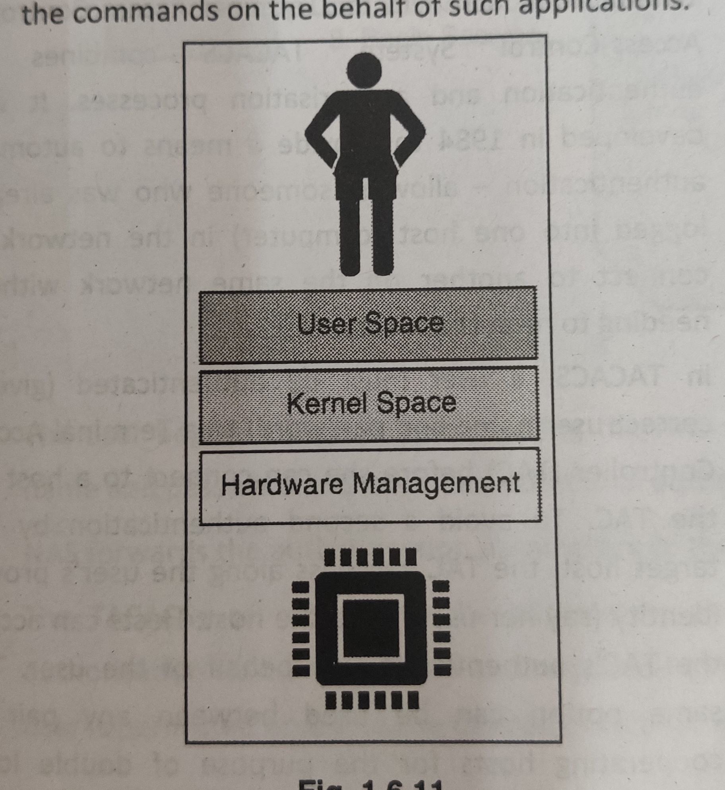
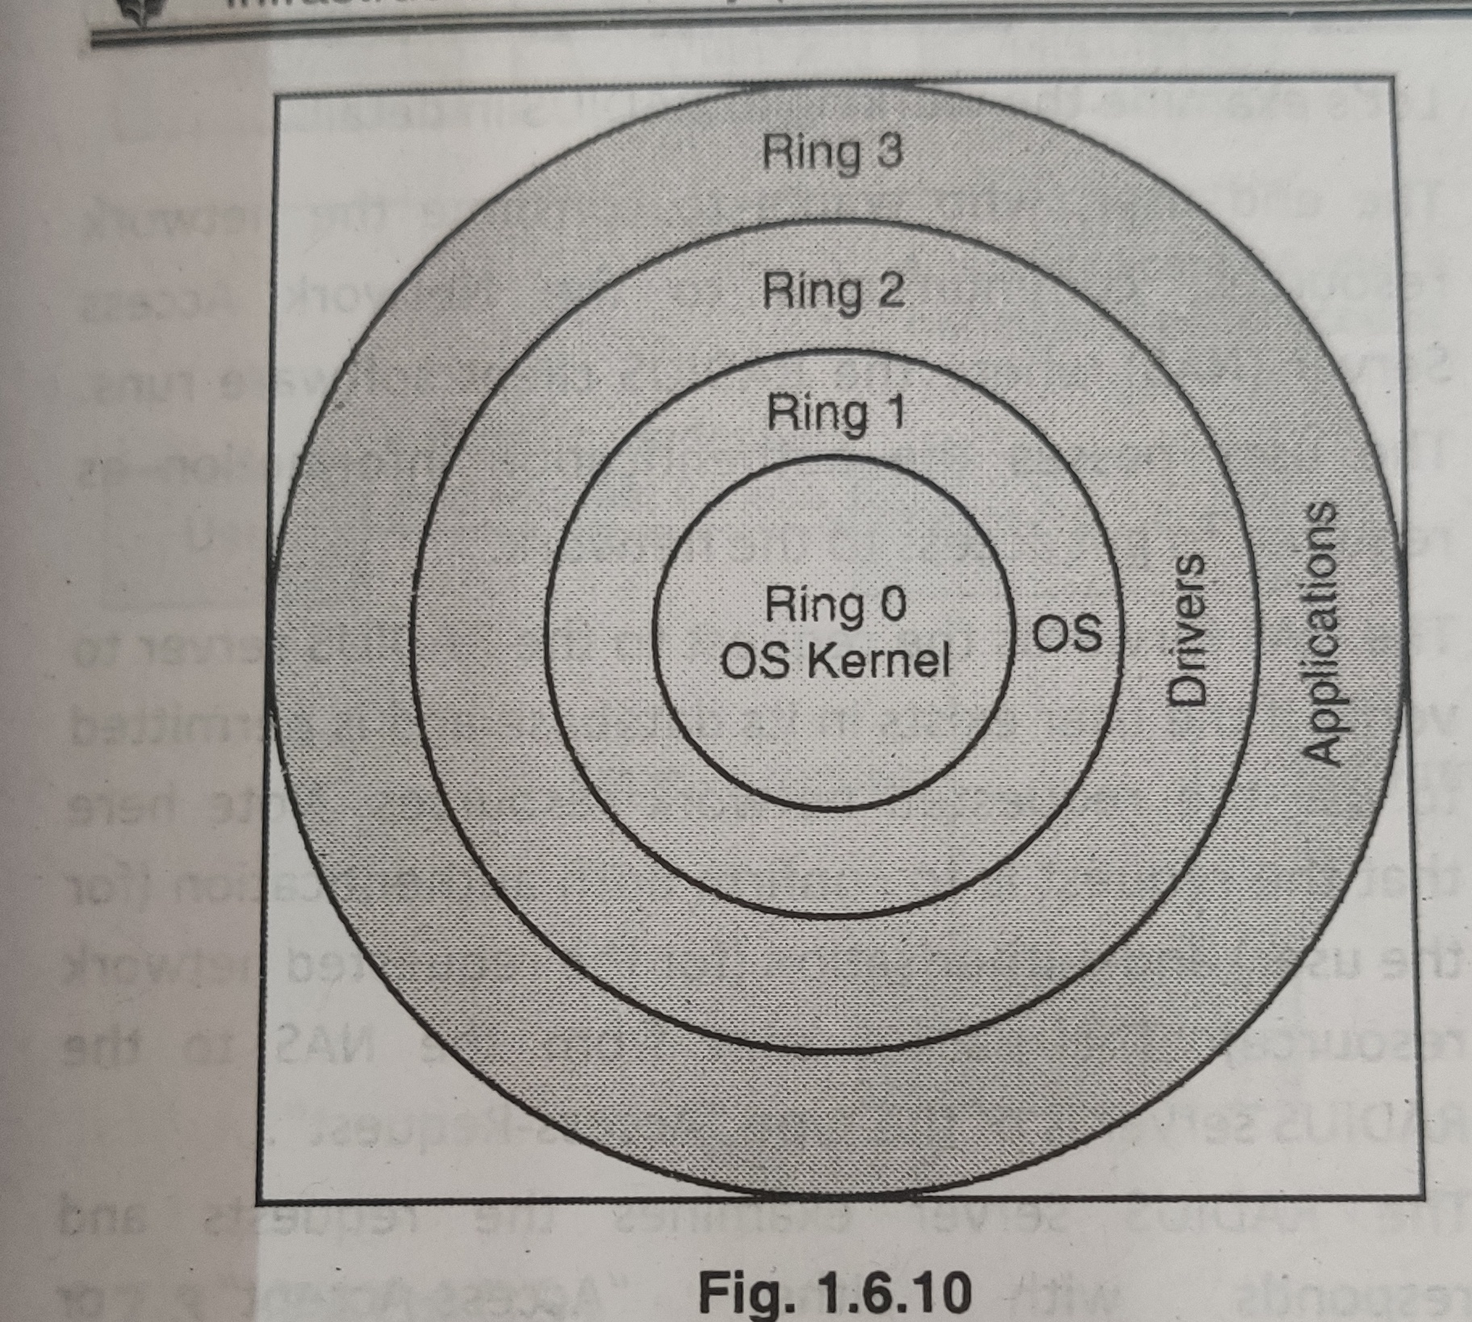
Practical Application of Biba Model
Operating system Architecture

Slide 39
Some Questions
Which of the following refers to a series of characters used to verify a user's identity?
Token Serial number
UserID
Password
Security ticket

Slide 40
Some Questions
Which of the following refers to a series of characters used to verify a user's identity?
Token Serial number
UserID
Password
Security ticket

Slide 41
Some Questions
Which type of access control allows owners to specify who can access their files?
Discretionary
Relational
Mandatory
Administrative

Slide 42
Some Questions
Which type of access control allows owners to specify who can access their files?
Discretionary
Relational
Mandatory
Administrative

Slide 43
Some Questions
The three primary methods for authentication of a user to a system or network are?
Authorization, Identification, and Tokens
Passwords, Encryption, and Identification
Identification, Encryption, and Authorization
Passwords, Tokens, and Biometrics

Slide 44
Some Questions
The three primary methods for authentication of a user to a system or network are?
Authorization, Identification, and Tokens
Passwords, Encryption, and Identification
Identification, Encryption, and Authorization
Passwords, Tokens, and Biometrics

Slide 45
Thank you !

